Slide 1

Roles & Granting Privileges

Slide 2
What are Roles?
Roles are a collection of privileges or access rights.
When there are many users in a database it becomes difficult to grant or revoke privileges to users. So, if you define roles, you can grant or revoke privileges to roles.
Thus, any user with a particular role will have or denied such privileges

Slide 3
Important to Note
A role can be granted to users or another role or applications
A user can have access to several roles.
Several users can be assigned the same role.

Slide 4
Types of Role
Application Roles
Users Role
You grant an application role all privileges necessary to run a given database application. Then, you grant the secure application role to other roles or to specific users.
An application can have several different roles, with each role assigned a different set of privileges that allow for more or less data access while using the application.
You create a user role for a group of database users with common privilege requirements.
You manage user privileges by granting secure application roles and privileges to the user role and then granting the user role to appropriate users.

Slide 5
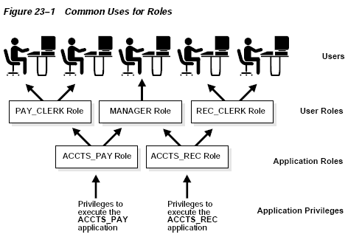

Slide 6
Assigning Roles by DBA
Steps are as follows
First, the DBA creates the role.
Next, the DBA grants privileges to the role.
Finally, the administrator assigns the role to users.

Slide 7
Creating a Role
Syntax:
CREATE ROLE role_name [ NOT IDENTIFIED | IDENTIFIED BY {password} ] ;
Note:
If both the NOT IDENTIFIED and IDENTIFIED phrases are omitted in the CREATE ROLE statement, the role will be created as a NOT IDENTIFIED role by default.

Slide 8
About CREATE ROLE
The role_name phrase is the name of the new role that you are creating. This is how you will refer to the grouping of privileges.
The NOT IDENTIFIED phrase means that the role is immediately enabled. No password is required to enable the role.
The IDENTIFIED phrase means that a user must be authorized by a specified method before the role is enabled.
The BY password phrase means that a user must supply a password to enable the role.

Slide 9
Example CREATE ROLE
The first example creates a role called test_role.
CREATE ROLE test_role;
This second example creates the same role called test_role, but now it is password protected with the password of test123.
CREATE ROLE test_role IDENTIFIED BY test123;

Slide 10
Assigning Privileges to Roles
Syntax:
GRANT privilege1 [,privelege2,…..,privilegeN] TO role-name;

Slide 11
Assigning Roles to Users
This is done by a DBA
Syntax: To assign the role to a user
GRANT role_name
TO username-list;
Here, username-list specifies username1, username2, username3,…., usernameN. Atleast one username to be present

Slide 12
Example the three steps
Step 1:
CREATE ROLE mca_student;
Step 2:
GRANT create session, create table, create view, create sequence, create procedure, create function, create package, create trigger
TO mca_student;
Step 3:
GRANT mca_student
TO user01,user02,user04;

Slide 13
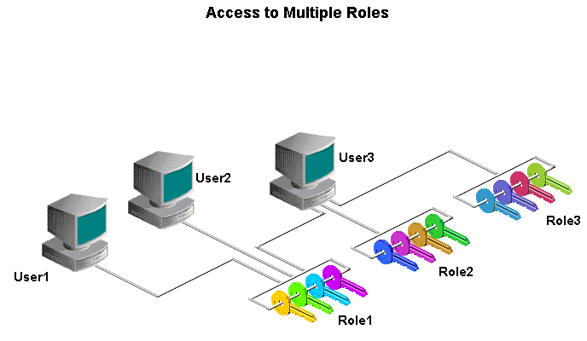
In the graphic displayed, User1, User2, and User3 are assigned to Role1. User3 is also assigned to Role2 and Role3.

Slide 14
System Role | Privileges Granted to the Role
CONNECT | CREATE SESSION
RESOURCE | CREATE DATABASE LINK, CREATE SYNONYM, CREATE ROLE, CREATE TYPE, CREATE VIEW, CREATE MATERIALIZED VIEW, CREATE PROCEDURE, CREATE PUBLIC SYNONYM, CREATE TABLE, CREATE TRIGGER, CREATE SEQUENCE
DBA | All System Privileges WITH ADMIN OPTION. A user with DBA role assigned can grant all privileges to any user. He/She can create, alter and drop users. He/She can insert, update, delete, drop other user objects. Any normal user can be extended the DBA role. Avoid granting the DBA role to normal users. DBA can drop an entire database users and all the objects owned by user in a single command
Pre-defined Roles
You can either create roles or use the system roles pre-defined by Oracle.

Slide 15
Viewing Roles
The pre-defined and created roles in the Oracle Server are stored along with the privileges, in data dictionary named ROLE_SYS_PRIVS.
To view such roles:
SELECT * FROM ROLE_SYS_PRIVS;

Slide 16
To Enable and Disable Role
The SET ROLE statement allows you to enable or disable a role for a current session.
Syntax:
SET ROLE{ role_name [ IDENTIFIED BY password ] | ALL [EXCEPT role1, role2, ... ] | NONE};

Slide 17
About SET ROLE
role_name phrase is the name of the role that you wish to enable.
IDENTIFIED BY password phrase is the password for the role to enable it. If the role does not have a password, this phrase can be omitted.
ALL phrase means that all roles should be enabled for this current session, except those listed in the EXCEPT phrase.
NONE phrase disables all roles for the current session. (including all default roles)

Slide 18
Enabling & Disabling Roles
Enabling
Disabling
To enable all roles:
SET ROLE ALL;
To enable password roles
SET ROLE test_role IDENTIFIED BY test123;
To disable roles test_role, mca_student
SET ROLE ALL EXCEPT test_role, mca_student;
To disable all roles:
SET ROLE NONE;

Slide 19
Dropping a Role
It is also possible to drop a role. The syntax for dropping a role is:
DROP ROLE <role_name>;
For example:
DROP ROLE mca_student;
This drop statement would drop the role called mca_student that we defined earlier.

Slide 20
What are System Privileges?
There are more than 100 system privileges for an Oracle 9i database.
These privileges are divided into DBA privileges and User privileges

Slide 21
DBA Privileges
DBA privileges belong only to the DBA and are more powerful than the user privileges.
The most commonly-used DBA privileges are:
CREATE USER
DROP ANY USER
BACKUP ANY TABLE
DROP ANY TABLE

Slide 22
Commonly Used DBA Privileges
DBA PRIVILEGES | DESCRIPTION
CREATE USER | The CREATE USER privilege enables the grantee to create Oracle users.
DROP USER | The DROP USER privilege enables the grantee to remove a user from the server.
BACKUP ANY TABLE | The BACKUP ANY TABLE privilege enables the grantee to make a backup of any table by using the export utility.
DROP ANY TABLE | The DROP ANY TABLE privilege enables the grantee to drop a table in any user’s schema.

Slide 23
User Privileges
Most users do not have DBA privileges. It is the job of the DBA to grant individual users the privileges that suit them.
The most commonly-granted user privileges are given:
CREATE SESSION
CREATE TABLE
CREATE SEQUENCE
CREATE VIEW
CREATE PROCEDURE

Slide 24
Commonly used User Privileges
USER PRIVILEGES | DESCRIPTION
CREATE SESSION | The CREATE SESSION privilege enables the grantee to connect to the Oracle server. This is the most basic privilege.
CREATE TABLE | The CREATE TABLE privilege enables the grantee to create a table. The table becomes a part of the user’s schema.
CREATE SEQUENCE | The CREATE SEQUENCE privilege enables the grantee to create a sequence. The sequence becomes a part of the user’s schema.
CREATE VIEW | The CREATE VIEW privilege enables the grantee to create a view. The view becomes a part of the user’s schema.
CREATE PROCEDURE | The CREATE PROCEDURE privilege enables the grantee to create a stored procedure, function or package. The privilege is essential for developers who write PL/SQL code.

Slide 25
GRANT Statement
A DBA runs a GRANT statement to allocate privileges to individual users.
Once the DBA grants a privilege, the user can use that privilege immediately.
Syntax:
GRANT privilege1[,privelege2,..,privilegeN] TO <userid>;

Slide 26
Example: Granting User Privileges
GRANT CREATE SESSION, CREATE TABLE
TO user15;
GRANT CREATE SESSION, CREATE TABLE, CREATE VIEW
TO user16;
GRANT CREATE SESSION, CREATE TABLE, CREATE VIEW, CREATE SEQUENCE
TO user23;

Slide 27
Object Privileges
An object privilege is a privilege or right to perform a particular action on a specific table, view, sequence, or procedure.
Each object has a particular set of grantable privileges as shown below.
We use a variation of the GRANT statement to allocate object privileges

Slide 28
Object Privileges
Object Privilege | Table | View | Sequence | Procedure
ALTER | √ |  | √
DELETE | √ | √
EXECUTE |  |  |  | √
INDEX | √
INSERT | √ | √
REFERENCES | √ | √
SELECT | √ | √ | √
UPDATE | √ | √

Slide 29
Granting Object Privileges
Syntax:
GRANT <privilege> [, privelege2, ……,privilegeN]
ON <object_name>
TO <user|Role|PUBLIC>;

Slide 30
About Syntax
The PRIVILEGE parameter after the GRANT clause specifies the privilege to be granted. Multiple privileges are separated by commas.
The ON clause followed by the object name specifies the object on which the privileges are granted.
The TO clause identifies the user or the role to whom the privilege is granted. The PUBLIC keyword grants object privileges to all the users in the database domain.

Slide 31
ALL keyword
The ALL keyword signifies all of the associated object privileges.
GRANT ALL
ON object_name
TO user|Role|PUBLIC;

Slide 32
Example: Object Privileges on Students Table
Group 1:
GRANT SELECT, INSERT, UPDATE
ON STUDENTS
TO user01,user 02, user04, user07, user 08, user09, user 10
Group 2:
GRANT SELECT
ON STUDENTS
TO user19, user21,user22,user23;
Group 3:
GRANT SELECT, INSERT
ON STUDENTS
TO user13,user14, user 15, user16, user17, user18;
Group 4:
GRANT SELECT, INSERT,UPDATE,DELETE
ON STUDENTS
TO user26, user27, user28, user29, user30;

Slide 33
Who can give Object Privileges?
There are two ways to grant privileges to an object to other users on the system.
One is to be the owner of the object.
The other way is to be granted a privilege with the WITH GRANT OPTION clause. This clause is used for giving other users on the system access to that object.

Slide 34
WITH GRANT OPTION
A user who receives a privilege along with the WITH GRANT OPTION privilege can grant that privilege to other users on the system.
However, if that user’s privilege is revoked, the other users on the system also lose that privilege.
The WITH GRANT OPTION privilege applies only to users and not to roles.

Slide 35
Example: WITH GRANT OPTION
GRANT SELECT
ON STUDENTS
TO user31
WITH GRANT OPTION;
What can user31 do?
user31 has only SELECT privilege on the table.
user31 has the right to grant only the SELECT privilege to to other users as well.
What happens if user31 looses the SELECT privilege?
The all other users whom user31 had given the same right will also be revoked

Slide 36
REVOKE statement
You can use the REVOKE statement selectively to remove one or more object privileges from one or more users.
The privileges that you name are revoked from the users you specify.
In addition, the privileges granted to other users through the WITH GRANT OPTION clause are also revoked when you run the REVOKE statement

Slide 37
REVOKE statement
Syntax
REVOKE privilege [, privilege,…..] ON object
FROM user
CASCADE CONSTRIANTS;
The CASCADE CONSTRAINTS keywords remove any referential integrity constraints defined for the object by means of the REFERENCES privilege.

